Slide 1
UNIFIED DIAGNOSTIC SERVICE
REQUEST UPLOAD SERVICE
BY
SHABBAR MOHAMMED

Slide 2
TABLE OF CONTENT
WHAT IS UDS?
WHY DO WE NEED DIAGNOSTIC IN VEHICLE?
DIFFERENCE BETWEEN COMMUNICATION PROTOCOL AND DIAGNOSTIC PROTOCOL
UDS PROTOCOL FRAME FORMAT
POSITIVE AND NEGATIVE RESPONSE
UDS ADDRESSING MODES
REQUEST UPLOAD SERVICE

Slide 3
WHAT IS UDS?
The word “Unified” means it is a common standard not a particular companies standard so the service and functionality will be the same for all the ECU manufacturers(OEM) The word “Diagnostics” means it is a technique to identify any kind of illness(faults) of the vehicle. It also allows us to reprogram and calibrate the sensors.
Tester to communicate with ECUs, each car is having OBD interface port with the help of an OBD interface cable we can connect with the car and we can able to read the fault codes or reprogram.

Slide 4
WHY DO WE NEED DIAGNOSTIC IN VEHICLE?
A modern vehicle has more than 100 ECUs, each ECUs performing specific functions like Battery management system, automatic gearbox, anti-lock braking system, infotainment unit, etc. So it’s difficult to test and diagnose vehicle systems when a fault occurs.

Slide 5
DIFFERENCE BETWEEN COMMUNICATION PROTOCOL AND DIAGNOSTIC PROTOCOL
Communication protocol means it is used to communicate between two microcontrollers or to communicate between a controller and a computer to transfer the data. In automotive electronics we have ECUs. These diagnostic protocols are used to identify the faults in ECU.

Slide 6
Uds protocol frame format:
UDS is a Request and Response based protocol based on client-server architecture and it is having unique service ID(SID).SID is the size of one byte and it ranges from 0x00 to 0x3E.
Basically, there are 4 types of frame format,
Request frame with sub-function ID
Request frame without sub-function ID
Positive Response frame
Negative Response frame

Slide 7
Conti..
SUB-FUNCTION ID
It is a part of the service ID and it is an optional field.
Under ECU RESET service ID(0x11),there are 3 function IDs are there.
1.Hard reset(0x01)
2.Key-off on Reset(0x02)
3.soft Reset(0x03)

Slide 8
POSITIVE RESPONSE FRAME
In UDS diagnostics, the tester act as a client, and ECUs act as a server. When the server (ECU)receives the service request from the tester, the server checks the message. If everything is fine then it executes the requested service and responds to the client with a positive response. If the response is positive, then the 6th bit of the SID should be 1.
For example,
Service ID – 0x35 => 0 0 1 1 0 1 0 1
For positive response 0 1 1 1 0 1 0 1 is equal to 0x75 (0x35 + 0x40).
In another way, we can say the positive response means SID+ 0x40, There is no logical reason for this. Simply it is defined in International standard IS0-14229-1.

Slide 9
NEGATIVE RESPONSE FRAME
In UDS diagnostics, the tester act as a client, and ECUs act as a server. When the server (ECU) receives the service request from the tester, ECU checks the message. If the server finds something wrong, then it executes the negative response and sends the Negative response code(NRC). There are some Negative Response Codes given below.
1.General Rejection-0x10
2.Sub-function Not Supported-0x12
3.Incorrect Message Length(IML)-0x13
4.Busy Repeat Request-0x21
5.Condition not correct-0x22
6.Request sequence Error-0x24
7.Request out of Range(ROOR)-0x31
8.Security Access Denied-0x33
9.Invalid key-0x35

Slide 10
UDS PROTOCOL ADDRESSING METHODS
To repair, read, write, or to flash the new software, the tester needs to connect the testing tool to the ECU. If we want to connect the ECU to the system, we need to assign the address.
There are 2 types of addressing methods.
Physical Addressing
Functional Addressing

Slide 11
PHYSICAL ADDRESSING
In physical addressing mode, If the tester knows which ECU is causing the issue, the tester can connect the testing tool directly to that particular ECU and get the fault code(DTC). To achieve this, each ECU should have its own ECU Identification Number. So the tester connects with the ECU and sends the request and gets the response from the ECU. This method is called as Physical Addressing method.

Slide 12
FUNCTIONAL ADDRESSING
In modern vehicles, a lot of ECUs are available based on the different OEMs. Suppose the tester knows there is a fault in the network(Bus) but he couldn’t able to find the exact fault causing ECU in the network. Now, the tester needs to take all the ECUs fault code (DTC) in the network.
In the vehicle, there will be a Global ECU Identifier, which will be implemented in all the CAN receivers. So the ECU can receive the request and give a response to the tester. This method is called as Functional Addressing method.

Slide 13
REQUEST UPLOAD SERVICE-0x35
Request upload service is the same as the Request download and it is used to send the request by the tester to read the downloaded firmware from ECU. The client must specify the address and firmware size.
This service is just the reverse of the 0x34 SID. Suppose you have downloaded some software after some time it gets crashed, to check the original file what you downloaded and now either it crashed or not you can upload to your computer and compare also.
Frame format would be same as request download service except for service ID.

Slide 14
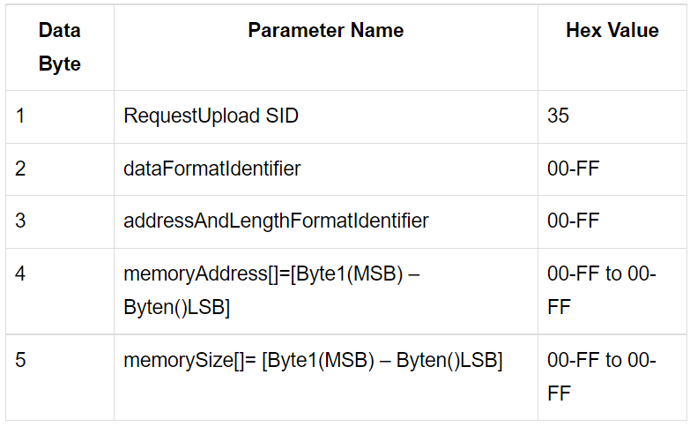

Slide 15
DATA FORMAT IDENTIFIER:
This data parameter is a one-byte value with each nibble encoded separately. The high nibble specifies the “compression Method”, and the low nibble specifies the “encrypting Method”. The value 00 hex specifies that no compression Method nor encrypting Method is used. Values other than 00 hex are vehicle manufacturer specific.
Address And Length Format Identifier:
This parameter is a one-byte value with each nibble encoded separately for identification of address and data in the memory array.
Bit 7 – 4: length (number of bytes) of the “memory Size” parameter;
Bit 3 – 0: length (number of bytes) of the “memory Address” parameter.

Slide 16
Memory Address:
The parameter memory Address is the starting address of server memory from which data is to be retrieved. The number of bytes used for this address is defined by the low nibble (bit 3 – 0) of the address Format Identifier. Byte in the memory Address parameter is always the least significant byte of the address being referenced in the server. The most significant byte of the address can be used as a memory Identifier.
Memory Size:
This parameter shall be used by the server to compare the uncompressed memory size with the total amount of data transferred during the Transfer Data service. This increases programming security. The number of bytes used for this site is defined by the high nibble (bit 7 – 4) of the address And Length Format Identifier.

Slide 17
THANK YOU

